Slide 1

Analysis of open-text time reference web probes on a COVID-19 survey
Kristen Cibelli Hibben, PhD; Valerie Ryan, PhD; Travis Hoppe, PhD; Paul Scanlon, PhD;
Kristen Miller, PhD; Zachary Smith, MA
With thanks to Ben Rogers, MS
Federal Committee on Statistical Methodology
Research & Policy Conference
November 2nd, 2021
The findings and conclusions in this presentation are those of the authors and do not necessarily represent the official position of the National Center for Health Statistics or the Centers for Disease Control and Prevention.
Notes:
I’d also like to acknowledge Ben Rogers who joined our work on item nonresponse detection.

Slide 2

Outline
The use of “since the Coronavirus pandemic began” as a time reference
Background and research questions
Methods
Results
Quality of open-text responses and item nonresponse detection
Background and research questions
Methods
Results
Discussion and next steps
Notes:
This presentation covers two areas of research – the first explores the use of “since the Coronavirus pandemic began” as a time reference for survey questions. The second examines the quality of open-text responses, which were collected to address the primary research area. Specifically, we explore approaches to detect item nonresponse and then examine the nature and extent of item nonresponse.

Slide 3
Time reference: Background and research questions
Survey questions should be clear about the time period covered by the question (Groves et al., 2011)
If time period is not clearly specified or consistently understood, responses may vary for that reason, reducing data reliability (Fowler and Cosenza, 2013)
Debate about the use of “since the Coronavirus pandemic began” as a time reference in survey questions
Research questions:
How consistently do people understand “when the Coronavirus pandemic began”?
To what extent does this align with when the pandemic began affecting their lives?

Slide 4
Time reference: Methods
NCHS’s Research and Development Survey (RANDS) https://www.cdc.gov/nchs/rands/index.htm
RANDS During COVID-19 – Multi-round web/phone survey
Topics:
Round 1 fielded June-July 2020: 13,020 Completes
6,800 AmeriSpeak probability-based sample = 23.0% weighted cumulative response rate/78.5% completion rate
6,220 Dynata opt-in panel
Health status, chronic conditions, depression and anxiety
Loss of work due to illness with COVID-19
Health insurance and health care access
Telemedicine access and use
COVID-19 related health care and behaviors
Reduced access to health care
Notes:
To address these research questions, we embedded a series of probes questions in our Research and Development Survey (RANDS).
Repurposed RANDS when the pandemic hit with the RANDS During COVID-19 Surveys.
This is the weighted cumulative RR--that is from panel sampling to survey complete. The survey completion rates (survey sample to completes) were much higher (high 70s./80s IIRC) – out of 8,663 sampled units.

Slide 5
Time reference: Methods, continued…
The probes:
When do you think that the Coronavirus pandemic began? Your best guess is fine.
When did the Coronavirus pandemic first affect your daily life? Your best guess is fine.
Why do you say that?
Each was fully open-text
Applied computer-assisted techniques to:
Review and remove possible personally identifying information (PII) (see appendix)
Clean date responses
Automate and assist in identifying item nonresponse
Notes:
There was some discussion about using date fields for the first two probes, but we decided to keep these open-ended. As expected, this did result in some rather messy data, but, also as expected, it yielded richer data by allowing respondents to report broader timeframes – such as “Fall 2019” among other types of answers, which we’ll see more of shortly.

Slide 6
Date cleaning
Preponderance of date responses lent itself to automation
Rule-based approach, machine learning in Python
Simple rule fixes (e.g., “October” → “October 2019”)
Advanced rule fixes (“Fall” → 9/1/2019, 10/1/2019, 11/1/2019)
Challenges
Didn’t catch all responses
“4 months ago”
Tricky responses
“In March. My place of work was forced to close entirely, so I and all of my co-workers lost our jobs in March.” [emphasis added]
Notes:
For the date matching and cleaning – we wanted to try to automate this process because – of the amount of data – which would make it very time-consuming and error-prone to clean by hand.
Further – the preponderance of date responses lends itself well to automation.
Data Scientist colleague, Travis Hoppe, worked with us to apply a rule-based approach building on an existing date-detecting program in Python.
A bunch of cases were resolved using simple rule fixes (e.g., “October” → “October 2019”)
But we also had to develop some more advanced rule fixes (“Fall” → 9/1/2019, 10/1/2019, 11/1/2019)
We were able to resolve all but approximately 500 cases this way, however, there were some challenges, for example,
Challenges
Didn’t catch all responses – RELATIVE RESPONSES – THESE WE DID MANULLY
e.g., “4months ago” (based on date of the interview)
Tricky responses – PROGRAM COUNTED TWO DATES BUT THERE WAS REALLY JUST ONE
“In March. My place of work was forced to close entirely, so I and all of my co-workers lost our jobs in March.” [emphasis added]
At one point, we determined that we were getting diminishing returns by adding rules to the python script and that it would make more sense to resolve the remaining cases by hand. Many thanks to Valerie for doing the heavy lifting here.
A final and thorough review of the data also turned out to be a good thing because there were some tricky cases where the program didn’t necessarily do the right thing – as in the case with March mentioned twice.
There was definitely some time-savings with this process here but it wasn’t perfect. However, we believe that what we learned and have put in place for this research will apply in future project where dates are salient – like the NSFG.

Slide 7
Date probe results
 |  | Probe 1 When do you think that the Coronavirus pandemic began? (n=12,705) | Probe 2 When did the Coronavirus pandemic first affect your daily life? (n=12,650)
In-scope responses | 1 date | 7,726 | 9,608
 | More than 1 date | 2,273 | 189
Out-of-scope responses | Dates before 2019† | 66 | 8
 | Gibberish‡ | 46 | 14
 | Too relative or no date* | 96 | 134
 | Refused to say ** | - | 22
Missing/other invalid responses |  | 2,498 | 2,675
† Includes possible mistakes in typing: “4/1/2010”, conspiracies and/or confusion: “In 2012, because that’s when I had it.”
‡ Nonsensical responses, such as “fmadsjxcj”
* Responses such as “a lifetime ago”, “after I turned 18”, and “when we were ordered to stay home”
** Respondents say the pandemic has not affected their daily lives
Notes:
The script identified 7,726 single date responses to the first probe and 9,608 to the second.
Bunch of people reported more than one date – particularly for the first probe. Many noted that the pandemic began in China on one date and reached the United States on another. Some actually noted that it depends on “how you define pandemic.” This manual review also enabled us to identify some interesting patterns and quantify the out-of-scope responses.

Slide 8
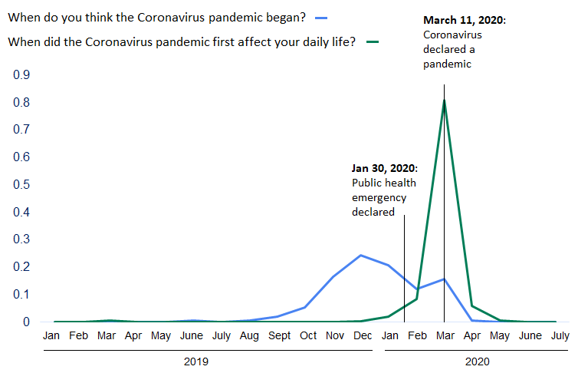
Date probe results
Proportion of responses
Notes:
Here we have plotted the dates from the first and second probe. All responses (both 1 date and multi-date) are included.
Those with more than 1 date were weighted by # of dates they provided. So, someone who answered “Fall” would get 1/3 for Sept, 1/3 for Oct, and 1/3 for Nov, whereas someone who answered “October 2019” would get 1 full point for Oct. We then divided the frequencies by the total so the y-axis represents percentages (ranges from 0 – 1).
YOU CAN SEE THAT Rs DO NOT HAVE A CONSISTENT UNDERSTANDING OF WHEN THE CORONAVIRUS PANDEMIC BEGAN. THERE IS A WIDE DISPERSION OF RESPONSES BUT A GENTLE PEAK AROUND THE END OF 2019 AND THE BEGINNING OF 2020.
For the ‘when did the pandemic start’ line, no single month got more than 25% of the responses. The top responses were 24% for December, 21% for January, 17% for November, and 16% for March.
FOR THE SECOND PROBE, THERE IS A VERY NOTICABLE SPIKE AT MARCH 2020 WITH over 80% of the dates given for that question in March.
WHO dates noted on the graph.

Slide 9
Item nonresponse detection: Background and research questions
Lacked time to develop closed-ended probes, per our usual approach
Saw opportunity to explore the quality of open-text responses, specifically the prevalence and nature of item nonresponse
Research questions:
What is the prevalence and nature of item nonresponse to open-ended questions?
How does this differ by key socio-demographics?

Slide 10
Item non-response detection: Background, continued…
Existing ways of categorizing item non-response
Behr et al. (2012) – “nonproductive” responses
Meitinger et al. (2021) – indirect (soft) versus direct (hard) refusals
Kaczmirek et al. (2017) → tool EvalAnswer (available on GitHub)*
Complete nonresponse: blank text box
No useful answer: e.g., “dfgjh”
Don’t knows: e.g., “I have no idea”; “DK”; “I can’t make up my mind”
Refusals: e.g., “no comment”; “see answer above”
Other: insufficient to code e.g., “it depends”; “just do”; “just what it is”
Single word: e.g., “economy”
Too fast: < 2 seconds to answer
* https://git.gesis.org/surveymethods/evalanswer
Notes:
We adapted EvalAnswer’s (Kaczmirek et al., 2017) regular-expressions and added some additional gibberish detection.

Slide 11
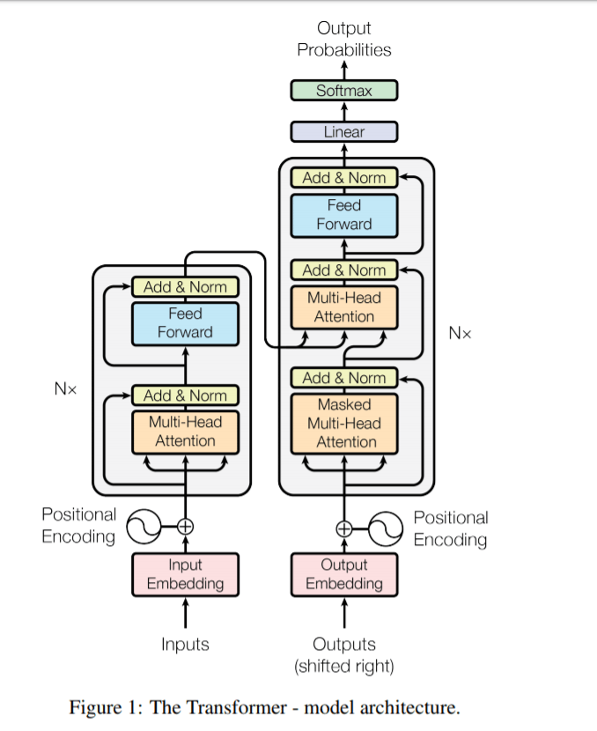
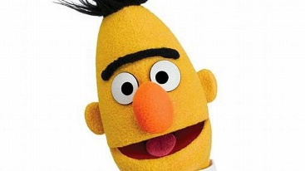
Item nonresponse detection: Methods
Adapted EvalAnswer
Missed some gibberish; limited due to reliance on rules or regular expressions (reg-ex)
Developed additional gibberish detection
Fine-tuned a Bidirectional Transformer for Language Understanding (BERT)* model using Simple Contrastive Sentence Embedding (SimCSE)**
Uses natural language processing (NLP) – interprets/understands language
Further training via human coding
* https://arxiv.org/abs/1810.04805
** https://arxiv.org/abs/2104.08821

Slide 12
Item nonresponse detection: Methods, continued…
Our working taxonomy:
Complete nonresponse: Blank text box
No useful answer or “Gibberish”: e.g., “dfgjh”
Don’t knows: e.g., “I don’t know”; DK; idk; etc.
Refusals: e.g., (“no comment”; “Because”; “none”)
Other: non-useful response, non-codable – depends on probe and context
Risk of item nonresponse code: 0 Low risk/1 High risk – will assist “human in the loop” coding when applied to other data
The model assigns a score (0-1) for the extent to which a response falls into each of the item nonresponse categories
Notes:
So far – we’ve had success identifying item NR for the first 4 categories. We are currently refining identification of the “Other” category and low/high risk
The model has value beyond RANDS and has been applied on vaccine hesitancy in the State Department and in the free text responses from v-safe.

Slide 13
Item nonresponse detection: Active learning
Round 1
5 coders hand-coded 1,400 each, 200 overlapping with one other coder; full overlap for 500
Good consistency with most categories (gibberish, DKs, refusals)
Less consistency between valid versus “other” item nonresponse
Good results for identifying item nonresponse, but flagged more valids than we wanted
Round 2
2 coders reviewed and arbitrated the results to retrain the model
Focused on “edge” cases between valid and “other” nonresponse
Current model identifies a manageable amount of “edge” cases for project-specific human review
Notes:
To keep the assignments manageable, there is a reduced number of total items to code per person. Our objective was to get a large amount of coverage with two coders per response, and a small subset with all five coders for IRR (inter rater reliability). There are 1400 total samples per person. This gives us coverage of about 2,500 of the high-risk samples we’ve identified previously using one of our methods, 500 random samples, and 200 full overlap samples.

Slide 14
Item nonresponse detection: Results
 | Probe 3 – Why do you say that? (n=13,019) | %
Total item nonresponse | 2,530 | 19.5
Item nonresponse by type (as a % of total nonresponse)
Complete nonresponse (blank) | 496 | 19.6
No meaningful answer (gibberish) e.g., “dfgjh” | 186 | 7.4
Don’t know e.g., “I don’t know”; DK; idk, etc. | 255 | 10.1
Refusals e.g., “No comment”; “Because”; “none” | 377 | 14.9
Other non-useful response, non-codable | 1,216 | 48.1
 |  | 100.0
Overall item nonresponse (19.5%) seems in range for combination probability/opt-in sample
Types (e.g., don’t know, refusals, etc.) point to potential problems with probe
Notes:
19.5% is the percentage of item nonresponse

Slide 15
Item nonresponse: Further analyses
ANY type of item nonresponse and TYPE of item nonresponse by:
Education (less than a bachelor’s degree, bachelor’s degree or more)
Age in years (18-29, 30-44, 45-59, 60+)
Gender (male, female)
Race/ethnicity (Non-Hispanic White, Non-Hispanic Black, Hispanic, Non-Hispanic Other)
Panel type (probability-based, opt-in)
Survey mode (telephone, web) (AmeriSpeak included n=410 (6%) telephone)
Pearson’s chi-square tests with adjusted alpha level (0.05/12 tests = 0.0042) and Cramer’s V (see appendix for effect size interpretations)
These tests were used to describe the characteristics of the sample

Slide 16
Results summary: Any item nonresponse
Any item nonresponse is more likely among:
Younger respondents, particularly those aged 18-29
Non-Hispanic Black, Hispanic, and Non-Hispanic Other respondents*
Opt-in panelists
Those with less than a bachelor’s degree
Males
Web respondents
Effect sizes (Cramer’s V):
small-medium
small-medium
small-medium
small
small
very small
* Non-Hispanic Other includes groups that were too small to disaggregate, including American Indian or Alaska Native, Asian, Pacific Islander, Native Hawaiian, and people who identify as more than one race.

Slide 17
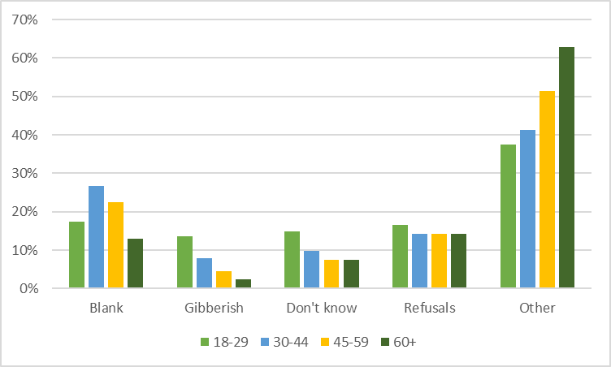

Item nonresponse type by age (in years)
% type of nonresponse
(Pearson’s $χ_{(12)}^{2}$ (n=2,530) = 182.28, p-value < 0.0001, Cramer’s V = 0.16, 95% CI [0.14, 0.18])
Notes:
More Gibberish, Don’t know and Refusals but less Blank and Other among 18-29
More Other as age increases

Slide 18
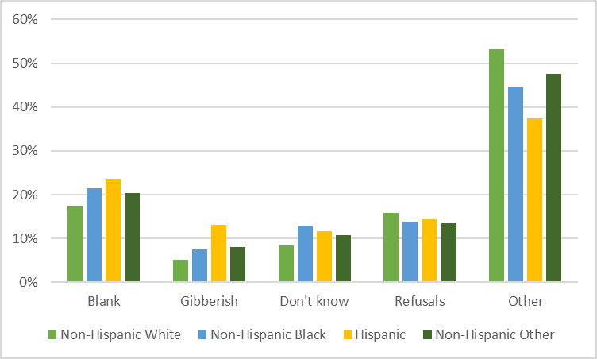

Item nonresponse by type race/ethnicity
* Non-Hispanic Other includes groups which were too small to disaggregate, including American Indian or Alaska Native, Asian, Pacific Islander, Native Hawaiian, and people who identify as more than one race.
% type of nonresponse
(Pearson’s $χ_{(12)}^{2}$ (n= 2,530) = 67.509, p-value < 0.0001, Cramer’s V = 0.09, 95% CI [0.08, 0.12])
Notes:
Less Blank but more Other among Non-Hispanic White
More Other among Non-Hispanic Other

Slide 19
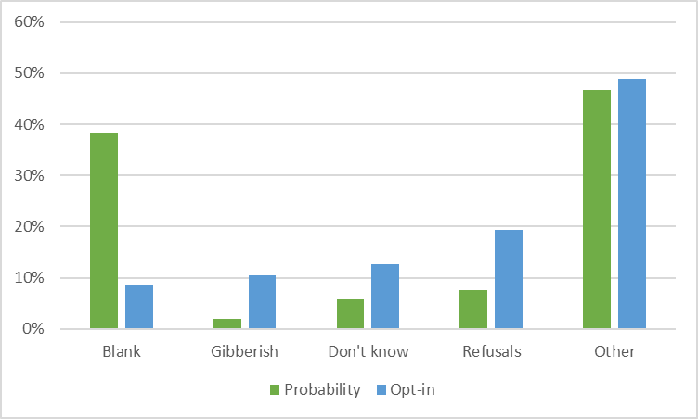

Item nonresponse type by panel type (probability v. opt-in)
% type of nonresponse
(Pearson’s $χ_{(4)}^{2}$ (n= 2,530) = 407.2, p-value < 0.0001, Cramer’s V = 0.40, 95% CI [0.37, 0.44])
Notes:
More Gibberish, Don’t know, Refusals, and Other but less Blank for opt-in
BUT: Less blank for the opt-in panel appears to be due to a difference in how blanks are handled. Probability panel allowed blanks and coded them as web skips. There were no blanks among the qualified complete cases for the opt-in panel; however, we do see a couple hundred blank responses among the non-qualified cases for the opt-in, which were not included in our analysis (we only included qualified completed cases).

Slide 20
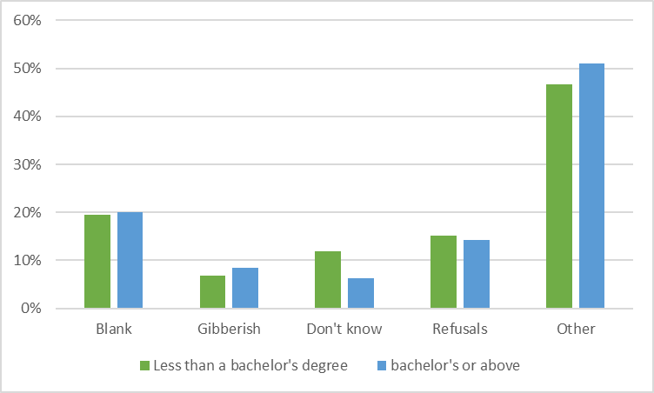

Item nonresponse type by education
% type of nonresponse
(Pearson’s $χ_{(4)}^{2}$ (n=2,530) = 21.718, p-value < 0.0002, Cramer’s V = 0.09, 95% CI [0.07, 0.13])
Notes:
More Don’t know among those with less than a bachelor’s degree
More Other among those with a bachelor’s degree or more

Slide 21
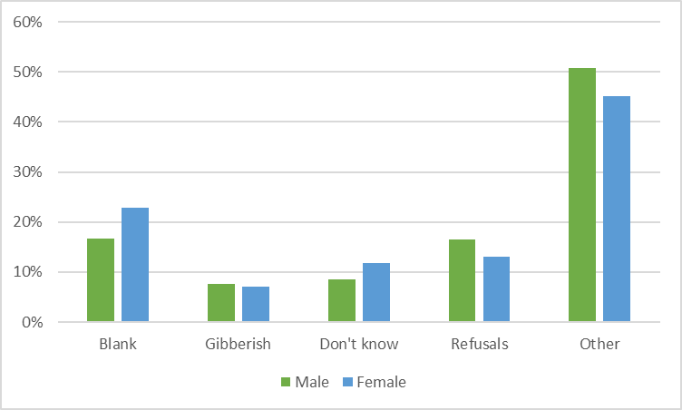

Item nonresponse type by gender
% type of nonresponse
(Pearson’s $χ_{(4)}^{2}$ (n=2,530) = 29.611, p-value < 0.0001, Cramer’s V = 0.11, 95% CI [0.08, 0.15])
Notes:
More Blank and Don’t know but less Refusals for females
More Refusals and Other among males

Slide 22
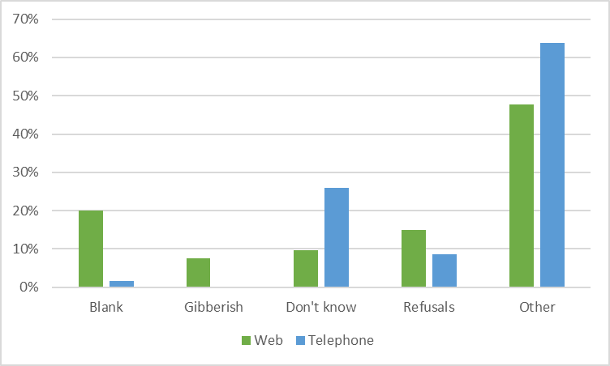

Item nonresponse type by mode
% type of nonresponse
(Pearson’s $χ_{(4)}^{2}$ (n= 2,530) = 33.342, p-value < 0.0001, Cramer’s V = 0.11, 95% CI [0.09, 0.16])
Notes:
More Blank, Gibberish, and Refusals on the web
More Don’t know and Other on the telephone

Slide 23
Results summary: Item nonresponse by type
Effect size (Cramer’s V):
Age
More “Gibberish”, “Don’t know”, and “Refusals” but less “Blank” and “Other” nonresponse among those aged 18-29
More “Other” nonresponse as age increases
Race/ethnicity*
Less “Blank” but more “Other” nonresponse among Non-Hispanic White
More “Other” nonresponse among Non-Hispanic Other
Panel type
More “Gibberish”, “Don’t know”, “Refusals”, and “Other” nonresponse but less “Blank” for opt-in – Note difference in policy re: blanks
medium
small-
medium
large
* Non-Hispanic Other includes groups that were too small to disaggregate, including American Indian or Alaska Native, Asian, Pacific Islander, Native Hawaiian, and people who identify as more than one race.

Slide 24
Results summary: Item nonresponse by type
Effect size (Cramer’s V):
Education
More “Don’t know” among those with less than a bachelor’s degree
More “Other” nonresponse among those with a bachelor’s or more
Gender
More “Blank” and “Don’t know” but less “Refusals” and “Other” nonresponse among females
More “Refusals” and “Other” nonresponse among males
Survey mode
More “Blank”, “Gibberish”, and “Refusals” on the web
More “Don’t know” and “Other” nonresponse on the telephone
small-medium
small-medium
small-medium

Slide 25
Discussion
Adapted RANDS and the use of open-ended probes to inform the design and interpretation of COVID-19-related measures
Results suggest that a month and year should be added to questions that use “since the Coronavirus pandemic began”
We recommend March 2020; coincides with WHO’s declaration and was widely cited by respondents in this study
Improved our methods and understanding of open-ended response data
Amount and nature of item nonresponse can help inform probe design
Need to continue to study and be mindful of open-text response data quality; important not to assume item nonresponse is distributed randomly across important subgroups, age in particular

Slide 26
Next steps
Further checking and refinement of our item nonresponse detector and release of a generalized version (possibly as a web-based application)
Further and advanced analyses of item nonresponse by subgroups
Carry out similar analysis with other open-text response data to see if patterns/results are replicated

Slide 27
Thank you!!
Please visit https://wwwn.cdc.gov/QBANK/Home.aspx to access our question evaluation reports
Contact us with any questions, ideas for collaboration, etc.
Kristen Cibelli Hibben - kcibelli@cdc.gov
The findings and conclusions in this report are those of the authors and do not necessarily represent the official position of the National Center for Health Statistics or the Centers for Disease Control and Prevention.

Slide 28
References
Behr, D., Kaczmirek, L., Bandilla, W., & Braun, M. (2012). Asking probing questions in web surveys: which factors have an impact on the quality of responses? Social Science Computer Review, 30(4), 487-498.
Cramér, Harald. 1946. Mathematical Methods of Statistics. Princeton: Princeton University Press.
Fowler Jr, F.J., & Cosenza, C. (2009). Design and evaluation of survey questions. The SAGE handbook of applied social research methods, 375-412.
Groves, R.M., Fowler, Jr, F.J., Couper, M.P., Lepkowski, J.M., Singer, E., & Tourangeau, R. (2011). Survey methodology. John Wiley & Sons.
Kaczmirek, L., Meitinger, K., Behr., D. (2017). Higher data quality in web probing with EvalAnswer: a tool for identifying and reducing nonresponse in open-ended questions. (GESIS Papers, 2017/01). Köln: GESIS - Leibniz- Institut für Sozialwissenschaften.

Slide 29
References
Kim H. Y. (2017). Statistical notes for clinical researchers: Chi-squared test and Fisher's exact test. Restorative dentistry & endodontics, 42(2), 152–155.
Meitinger, K., Behr, D., & Braun, M. (2021). Using apples and oranges to judge quality? Selection of appropriate cross-national indicators of response quality in open-ended questions. Social Science Computer Review, Vol. 39(3) 434-455.

Slide 30
Appendix/Extra Slides

Slide 31
Reviewing for PII
Ran a very inclusive entity detection script (Python)
Flattened file with columns [caseId, probe_name, text] and ~27.7K rows (entities)
Entities include: DATE, TIME, ORDINAL, CARDINAL, PERSON, ORG
Manual review of records that the computer deemed potential PII
ORG (n=1850) - e.g., Black Lives Matter, YMCA, but also “J&J&JW&WNSC” and an address strangely repeated (potential PII)
PERSON (n=822) – e.g., Bill Gates, Nancy Pelosi, Trump, but also Walmart, Bible, Zilch Nada
Create new version with any potential PII redacted
Submit move/copy data request form to the Data Protection Officer
Store data in a restricted access folder along with an audit file

Slide 32
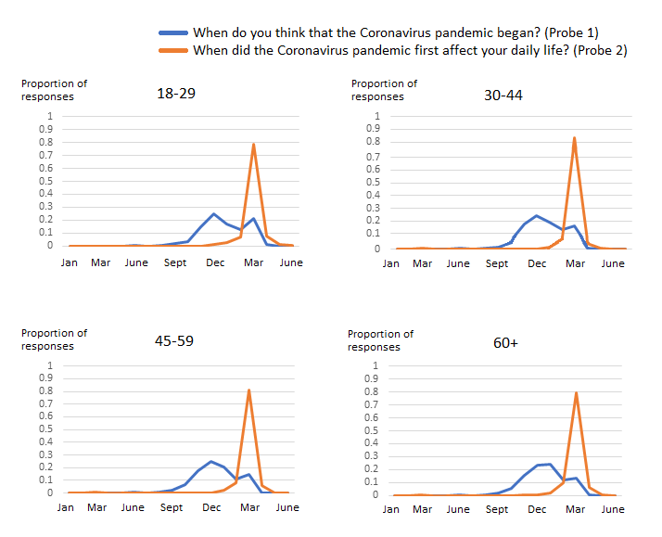
Date probe results by age (in years)
2019
2020
2019
2020
2019
2020
2019
2020
Notes:
Overall, the pattern of responses to the probes by age, education, and race and ethnicity are remarkably similar.
Overall, for all age groups, we see similar peaks for Probe 1 at December 2019, followed by a second, smaller peak around March 2020. However, these peaks are more noticeable for younger Rs (18-29), indicating slightly more alignment between the onset of the pandemic and when they believe that it began to first affect their daily lives. Whereas for other age groups, reported dates for Probe 1 are more widely dispersed around December 2019, particularly for those 60+. We also see smaller peaks at March 2020, compared to the younger respondents.
For Probe 2, we see the same noticeable spike at March 2020 for all age groups.

Slide 33
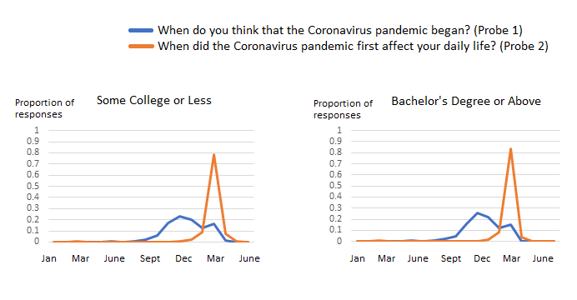
Date probe results by education level
2019
2020
2019
2020
Notes:
By education, we see a wider dispersion of responses around December 2019 for those with some college or less, compared to a slightly more noticeable peak for those with a Bachelor’s or above. Otherwise, very little difference can be observed in the distribution of responses by level of education.

Slide 34
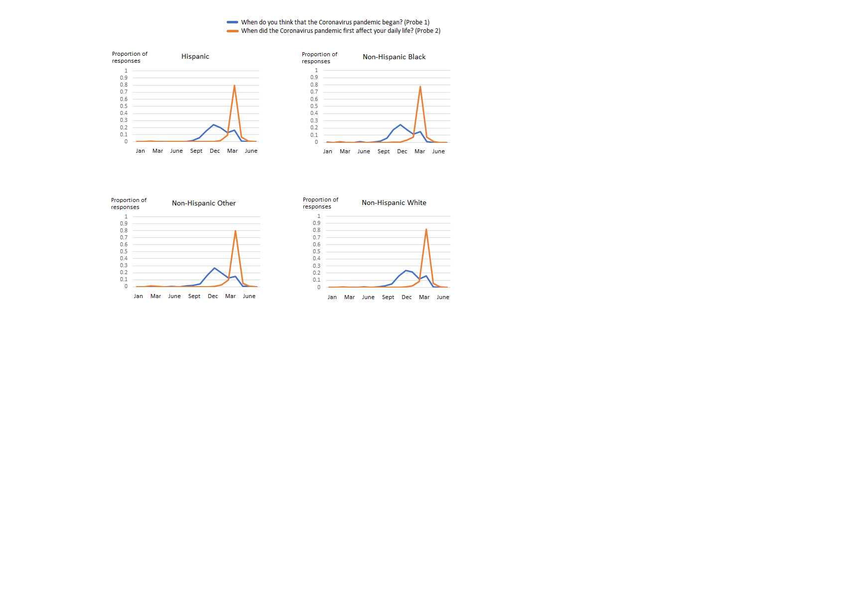
Date probe results by race/ethnicity
2019
2020
2019
2020
2019
2020
2019
2020
Notes:
A similar difference can be seen by respondent race and ethnicity. For White, non-Hispanic Rs, there is a wider dispersion of responses around December 2019, while there is a slightly more defined peak here for Black, non-Hispanic; Hispanic; and Other, non-Hispanic respondents.

Slide 35
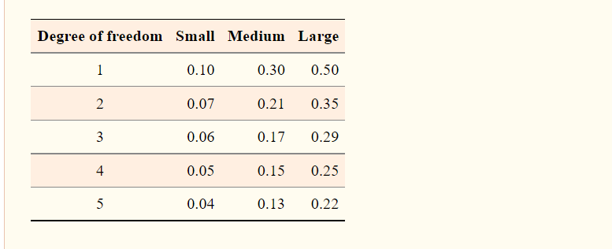
Cramer’s V effect sizes and interpretations
Note: Table found in Kim (2017), which draws on the original theory presented in Cramér (1946). Details citations provided in the References section.

